Slide 1
Building Blocks:
Components and Logic
Computer Science and Software Engineering
© 2014 Project Lead The Way, Inc.

Slide 2
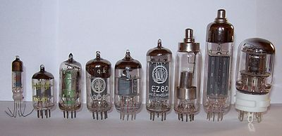
Vacuum Tubes
Notes:
In 1907 the vacuum tube made early electronics possible. The vacuum tube controlled the flow of electricity through a vacuum sealed container.

Slide 3
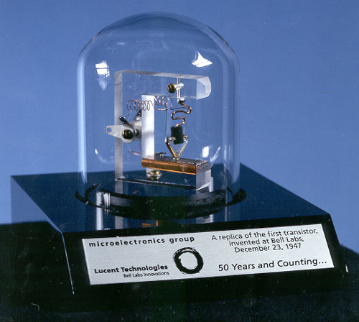
Transistors
Notes:
The first transistor was patented in 1925, although the first working point-contact transistor was not produced until 1947. Their work on that transistor earned Shockley, Bardeen, and Brattain the Nobel prize in physics in 1956.

Slide 4
Logic Tables
Display input and output values
Can have many inputs or just one
Must display all possible outcomes
 | AND
Input | Input | Output
A | B | A AND B
LOW | LOW | LOW
LOW | HIGH | LOW
HIGH | LOW | LOW
HIGH | HIGH | HIGH
Notes:
Logic tables are one common way of representing logic. Logic tables contain representations of data that can be represented in a binary fashion in any of the following ways: ON-OFF, True-False, 1-0, HIGH-LOW. We will use the HIGH-LOW representation here. Logic tables show every possible combination of inputs. For two inputs, there are only four possible combinations.

Slide 5







Logic Gates
AND
OR
NOT
NAND
NOR
XOR
XNOR
Notes:
Programs use logical statements like AND, OR, and NOT in high level programs. Pieces of hardware called logic gates can perform the same functionality at a hardware level and can be constructed from transistors and resistors. To give you a feel for how these gates can combine to make larger circuits, and even entire microchips, you will construct NAND gates using electrical components.
Each type of logic gate has a special symbol for use in drawing up circuit diagrams. In order to understand circuit diagrams, you will need to know these symbols. The three basic symbols are those for NOT, AND, and OR shown on this slide.
In order to create a symbol for a gate with an N (meaning NOT) at the beginning, you add a circle in front of the output line like the one in the NOT symbol.
An exclusive can be appended to OR based gates when the symbol has a line intersecting both of the input lines at the base of the gate. In this case an X precedes the gate name. XOR is what you commonly think of when you mean “one or the other but not both.”

Slide 6
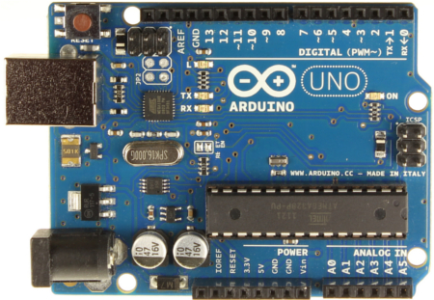
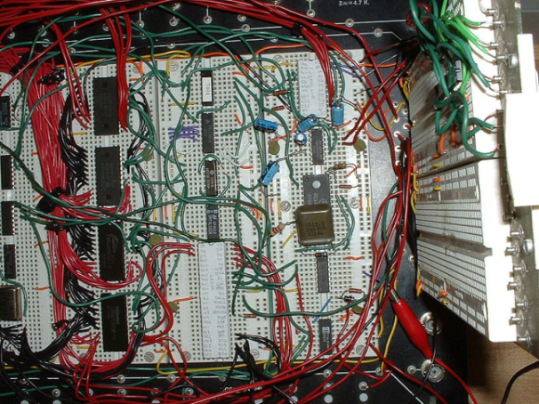
CMOS and TTL
CMOS used in Very Large Scale Integrated (VLSI) circuits like the ATMega.
TTL is still used in some applications. More waste heat is generated.
Notes:
Modern computers use complementary metal-oxide-semiconductors (CMOS) as the basic electrical building block for microcontrollers like the ATMega found on the Arduino, for RAM, and digital logic circuits. A CMOS device is itself built from transistors. Without the transistor the history of computing would look very different. The circuits you create in this activity will use transistor-transistor logic (TTL), meaning they are built from just transistors and resistors.
These will contain multiple logic gates and many transistors.
The ATmega48PA/88PA/168PA/328P is a low-power CMOS 8-bit microcontroller based on the AVR enhanced RISC architecture.

Slide 7
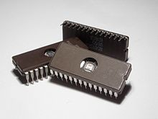
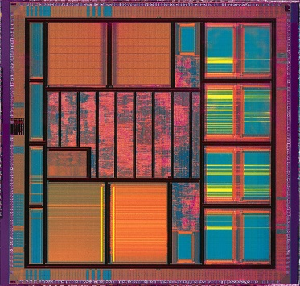
Integrated Circuits
Billions of transistors, small as a dime
Used in virtually all electronics
VLSI
How the most compact chips are made
Closer components means faster speeds
Notes:
The Xbox One contains 5 billion transistors in its CPU.
VLSI is a subcategory of integrated circuit standing for Very Large Scale Integration.

Slide 8
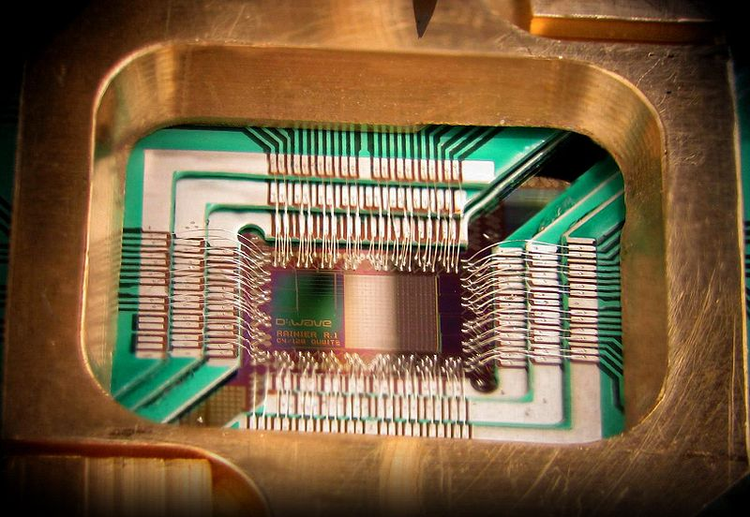
The Future
In order for computers to continue to observe Moore’s Law, non-traditional options are investigated
Optoelectronics
Nanotechnology
Quantum Computing
Notes:
The term microcomputer is applied to regular desktop computers, as they were much smaller than mainframes.
The Arduino UNO is considered a nanocomputer due to its size and power.

